Slide 1

FORAGE – DATA SCIENCE INTERNSHIP
Prepared by
Young Irivboje, Ph.D.
Data scientist

Slide 2
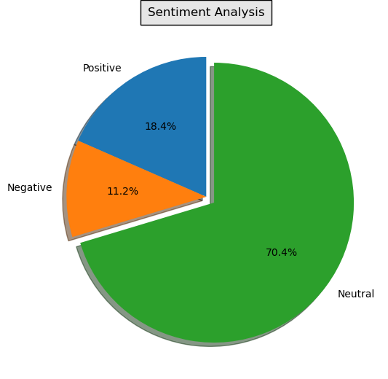
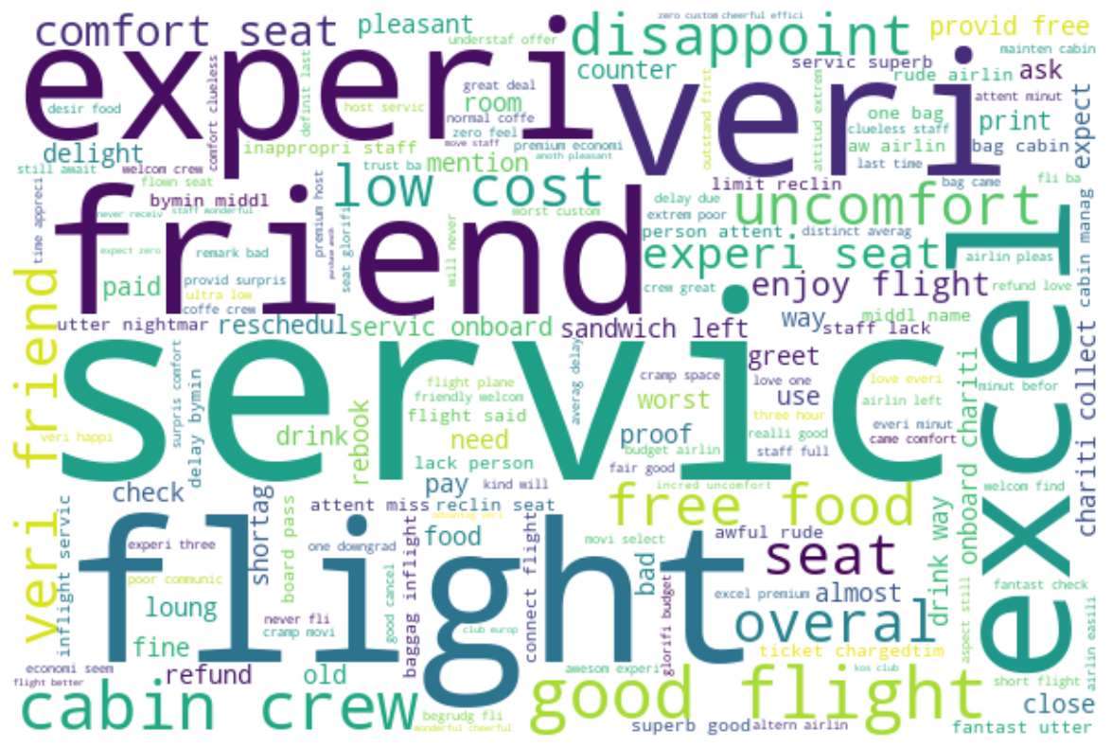
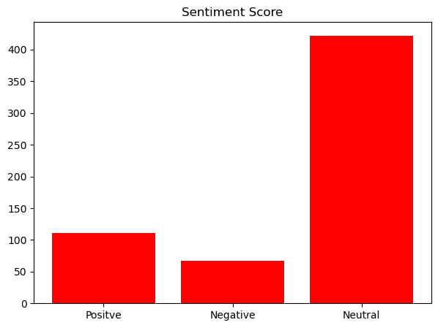
INSIGHTS FROM CUSTOMERS’ REVIEWS
Sentiment Analysis was performed using ML to predict customers’ behaviour A total of 600 entries of customer reviews were retrieved and used for the analysis
Sentiment Scores gotten after the analysis:
Positive – 110.61
Negative – 67.24
Neutral – 422.15
Pie Chart
Word cloud
Bar Chart

